Slide 2
Content
Project management in Outlook
A project in detail
Checklists
Task management
Project time tracking and documentation
Budgets and reports

Slide 3





Project management software for Outlook
InLoox for Outlook is…
…directly integrated in Microsoft Outlook
…reliable and customizable
…the solution for professional project management
InLoox for Outlook includes…
Project planning
Task management
Budgets
easy-to-use
+ 50,000 users
= a solution that works
Time tracking
Document management

Slide 4
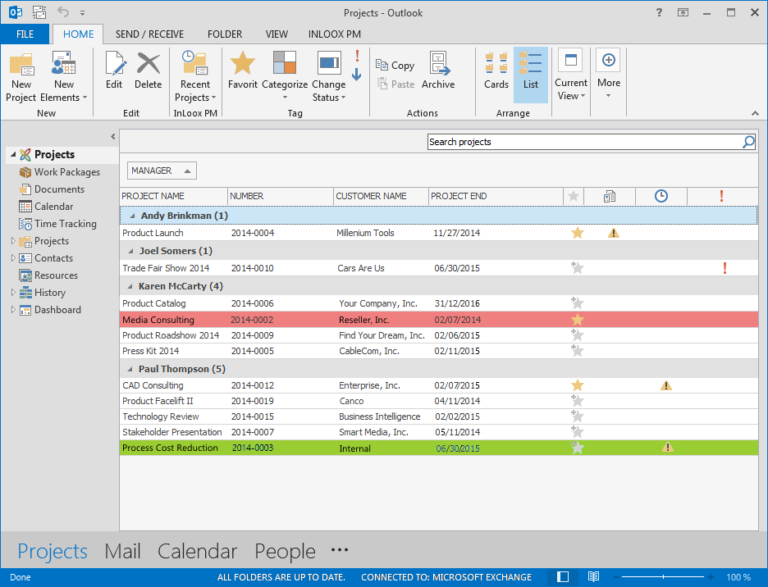
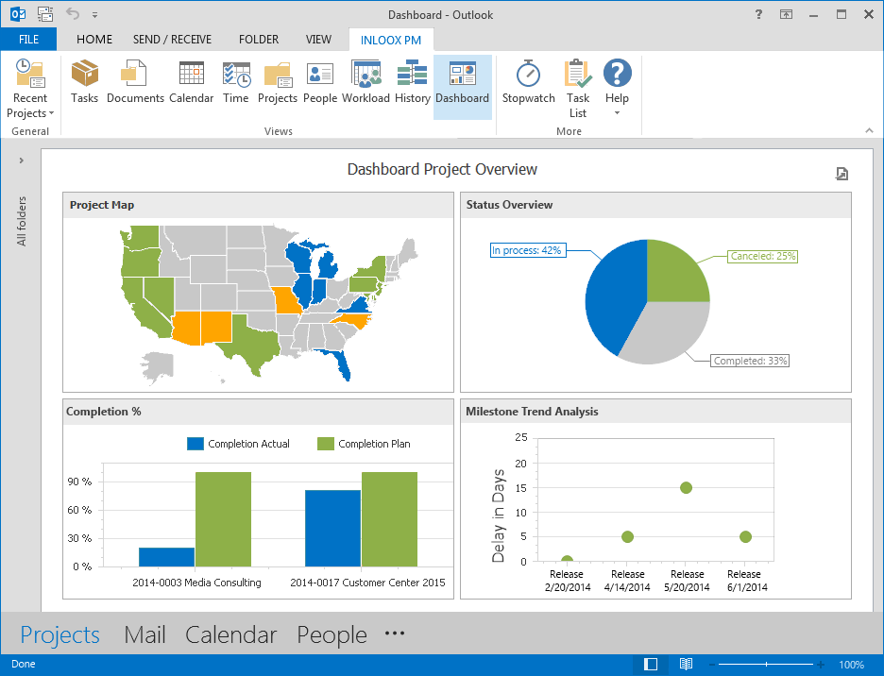
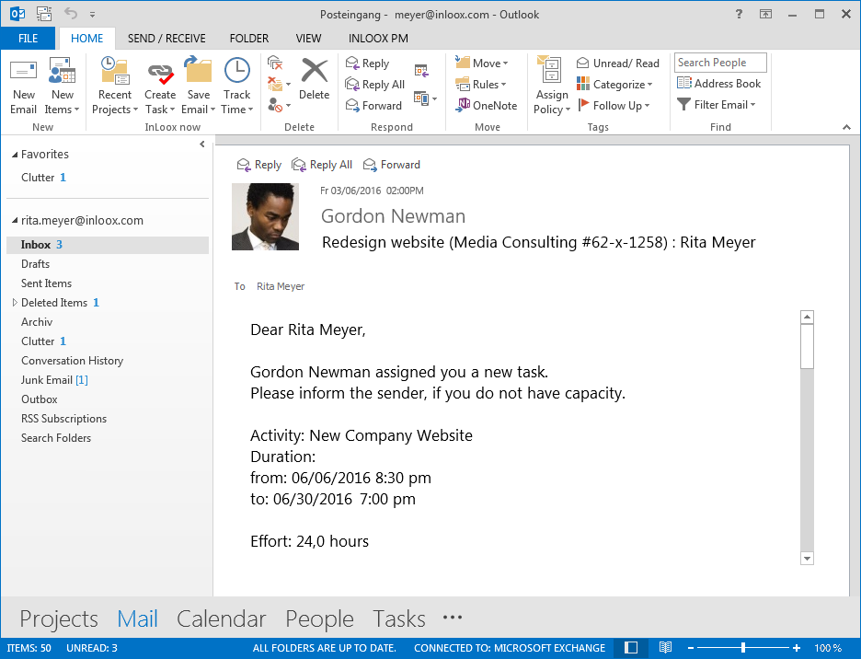
InLoox erweitert Microsoft Outlook
InLoox is directly accessible in Microsoft Outlook with just one click.
Create visual project dashboards comprised of various diagram options and data sources.
The project list gives you an overview of all projects in InLoox. Use custom rules to highlight certain projects.

Slide 5
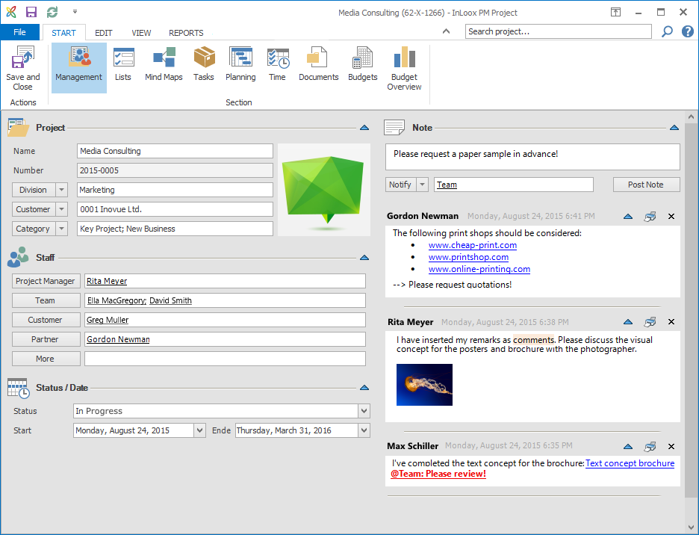
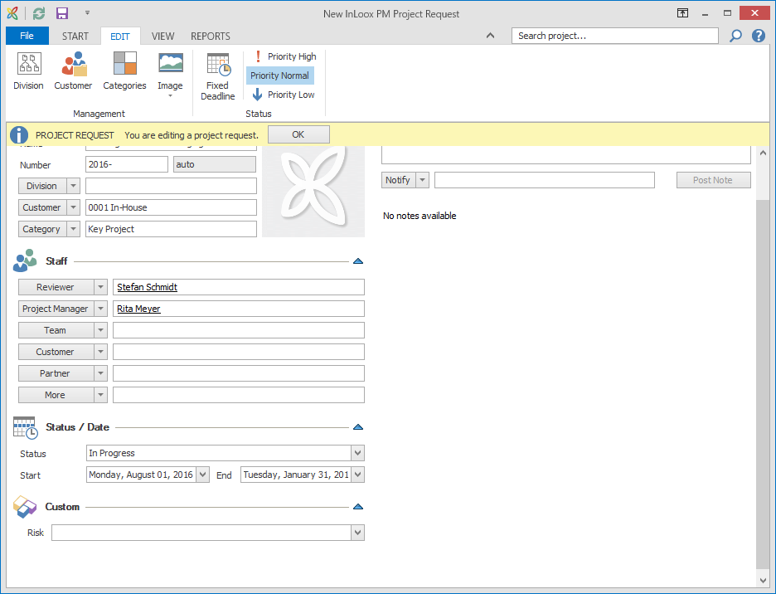
A project in detail
Clearly structure your project information with InLoox for Outlook.
InLoox uses your Outlook contacts as resources for projects. Project responsiblities are clearly defined.
Use custom fields to enhance your InLoox as you need it.
Use project notes to communicate with your project team. You can format the comments as needed.
Team members can file project requests and management can approve or reject them.

Slide 6
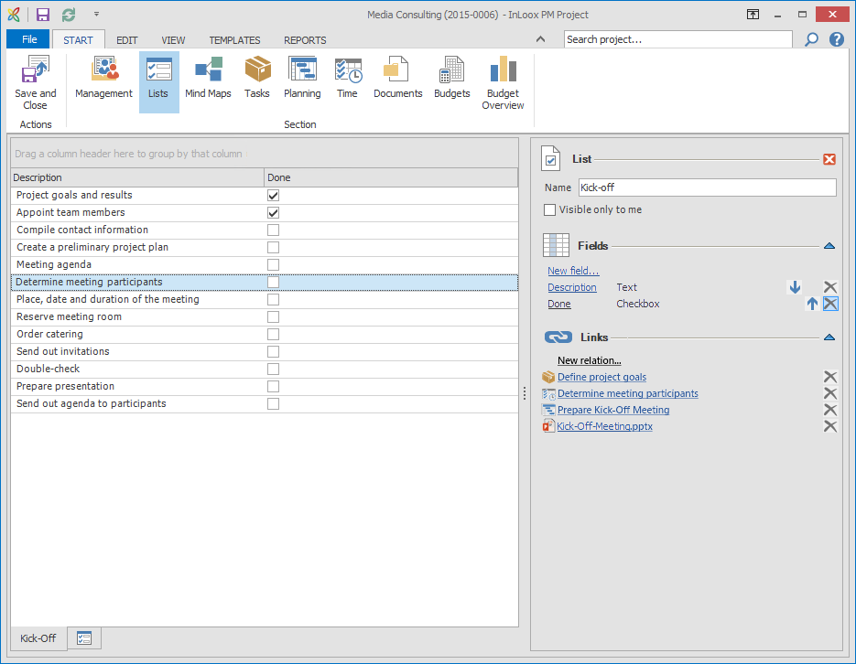
Lists
Lists
Create checklists for your projects and view them in the list or card view.
Customize your lists according to your own needs.
Link lists to project elements such as tasks ofr documents.

Slide 7
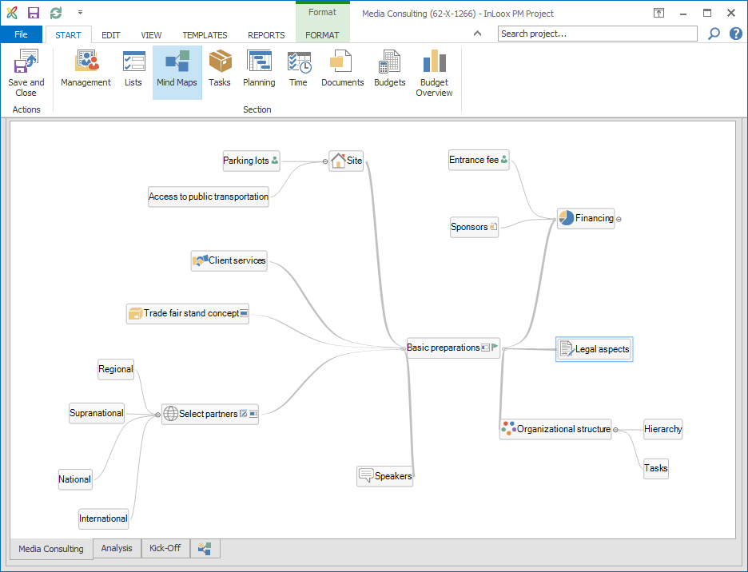
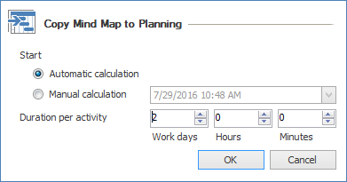
Collect, structure and brainstorm ideas
Mind maps
Collect and organize your ideas and project information directly in InLoox for Outlook.
Use icons to visualize ideas and attach project documents directly to your mind map nodes.
Define the progress of each node and assign resources to a node.
Copy mind maps into your project plan and turn your mind map nodes into tasks.

Slide 8
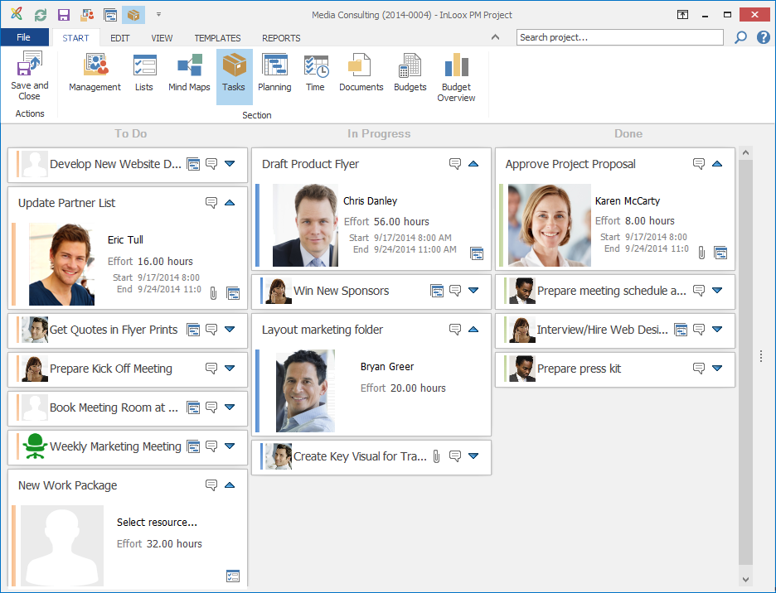
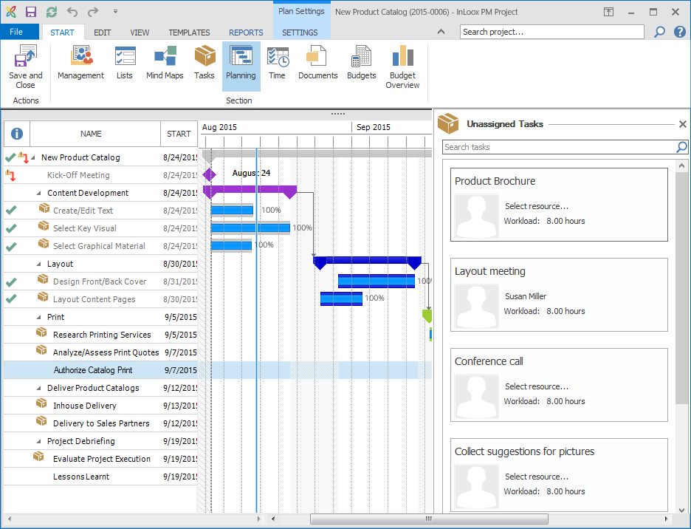
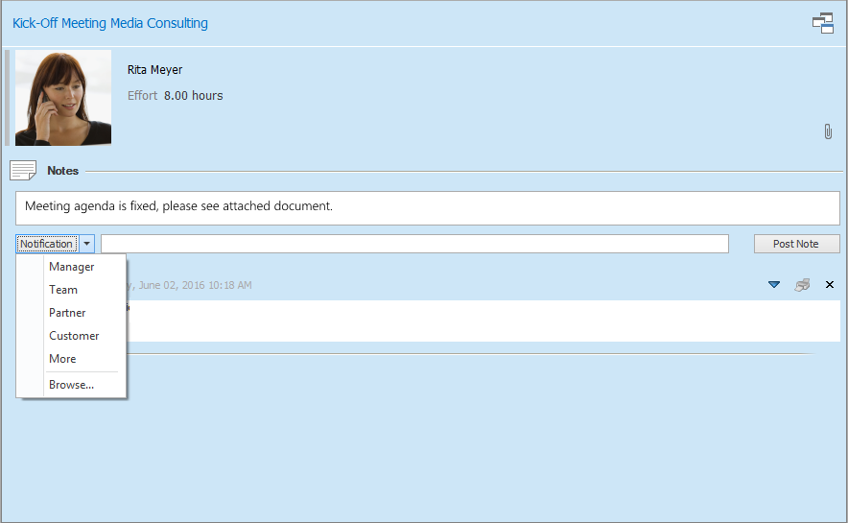
Task management
Tasks
Create, assign and organize your tasks in a virtual Kanban board – independently from your project schedule.
Leave a comment on a task and automatically notify team members about any changes.
Drag and drop tasks into your project plan to assign them to an activity. The project‘s progress will update automatically as soon as a task is marked as "Done“.

Slide 9
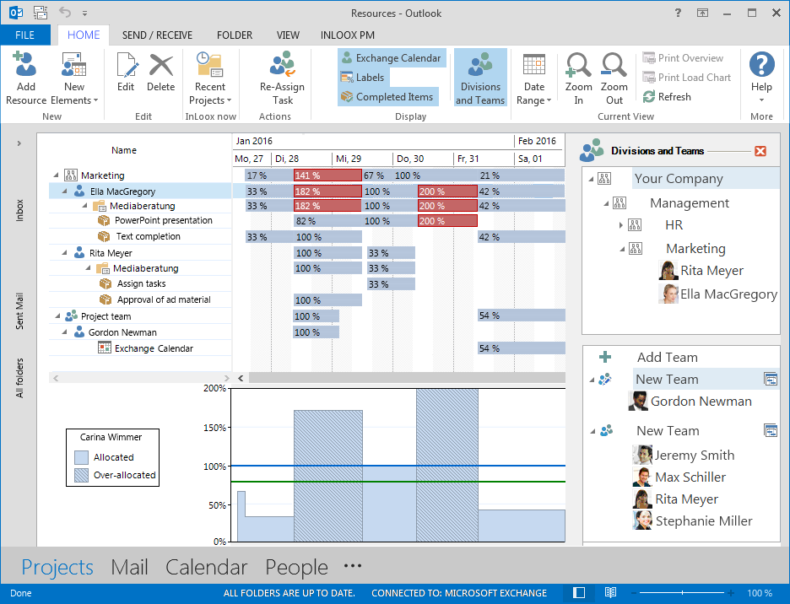
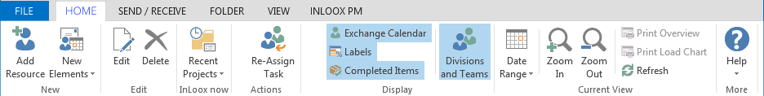
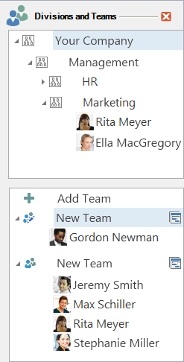
Visualize staff workload
Ressource & workload management
Keep an eye on your team‘s workload with InLoox for Outlook.
Get a comprehensive overview of your team‘s workload and the utilization of equipment.
InLoox for Outlook also takes information from your Exchange calendar into account.
Display the workload of specific teams or departments.

Slide 10
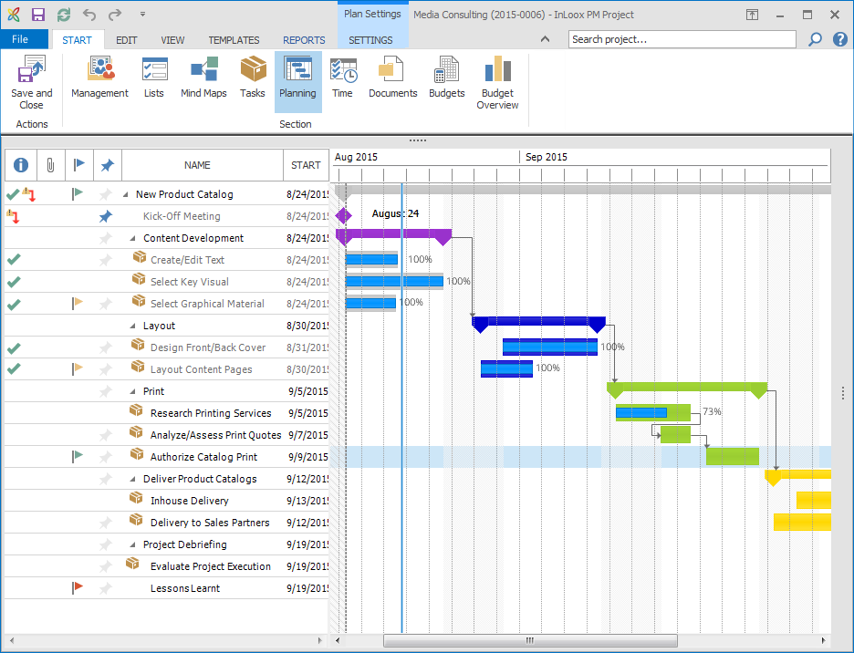
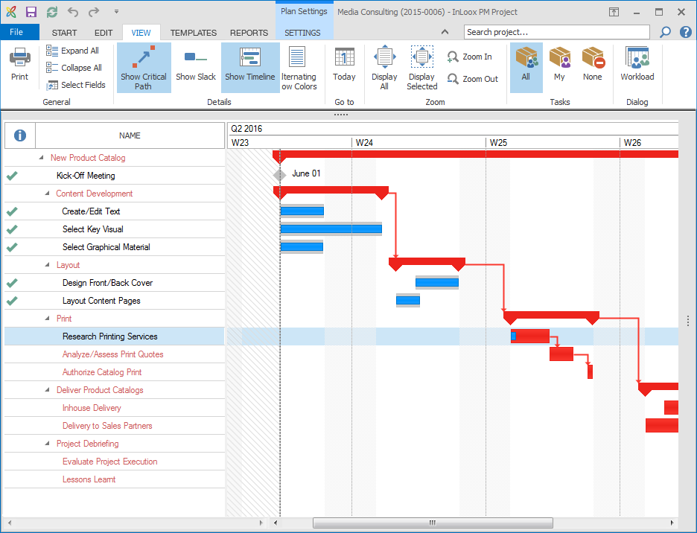
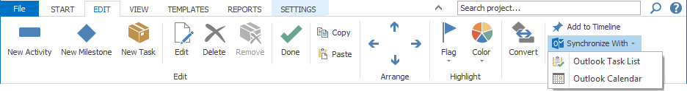
Keep your project schedule under control
Project scheduling
Plan simple or complex projects with InLoox for Outlook.
Critical path
Critical planning elements are highlighted in red.
Synchronization
Synchronize planning elements such as activities and milestones with Outlook Tasks or the Outlook Calendar.

Slide 11
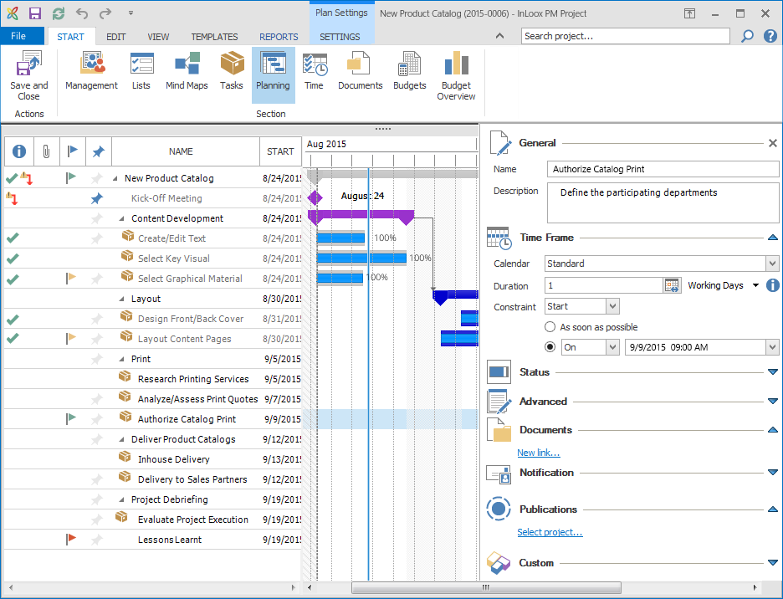
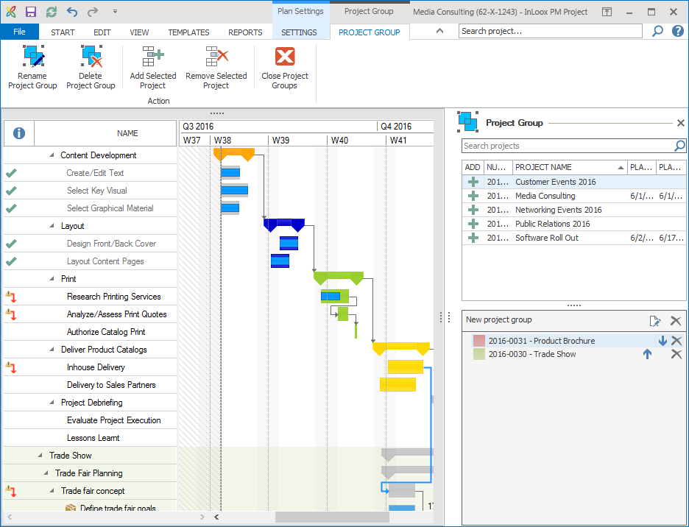
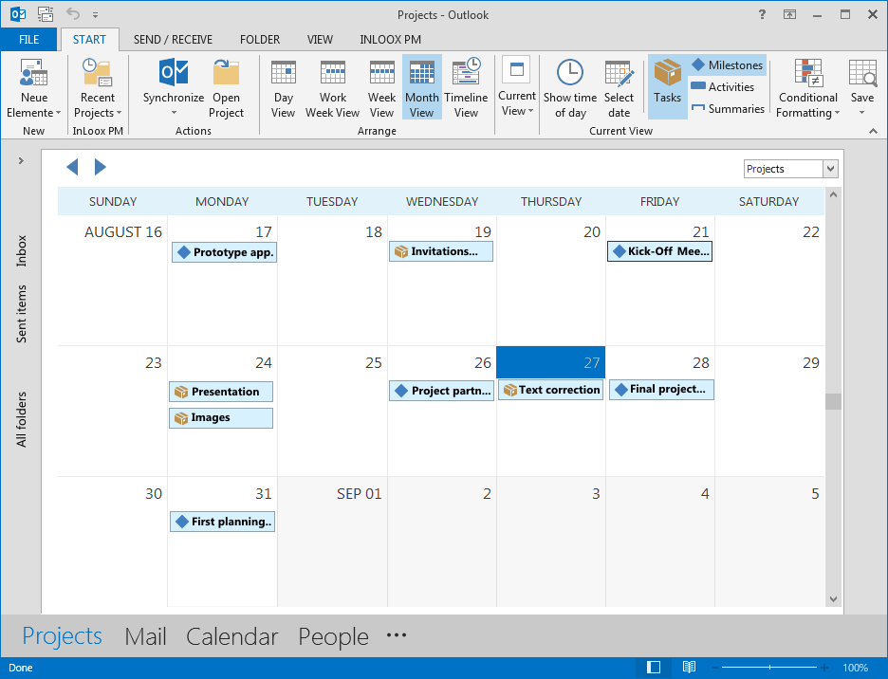
Professional project planning
Efficient scheduling
Display constraints, dependencies and the work calendar in InLoox for Outlook.
Project groups
Connect project plans of interdependent projects to get an overview of multiple projects at once.
Calendar view
The global calendar shows activities and milestones of each of your projects in one calendar view.

Slide 12
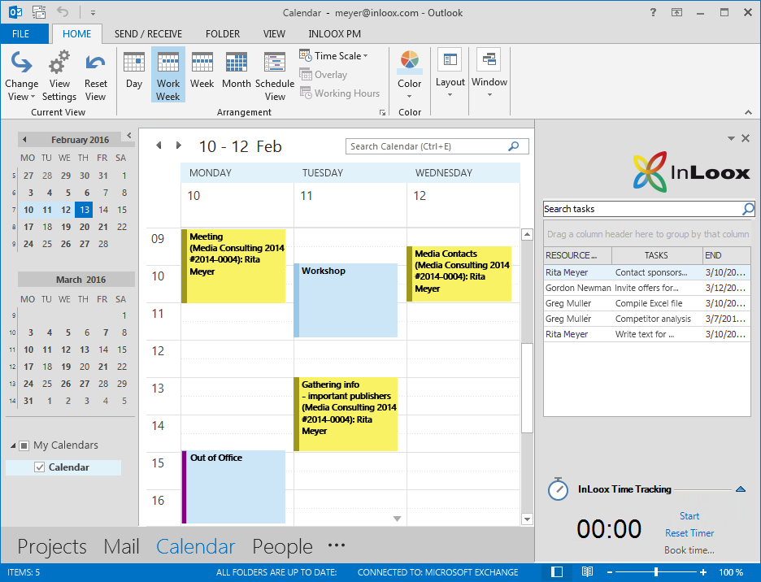
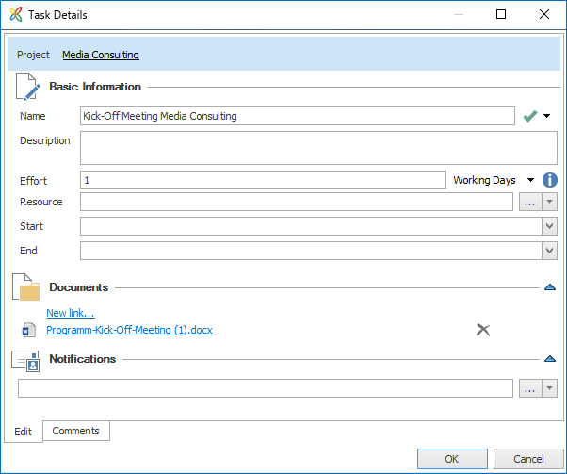
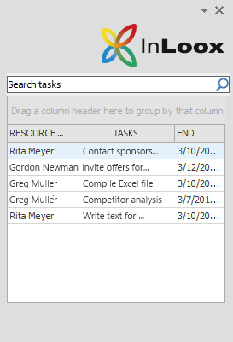

Rückmeldungen zum Projektfortschritt
InLoox for Outlook notifies project team members of new or overdue tasks.
The Outlook calendar and InLoox project plan are always synchronized and up-to-date.
Your open tasks are always in sight ín the tasks side panel.
Display task details with just one click.
Mark a completed task as "Done“ and the project plan will update itself.

Slide 13
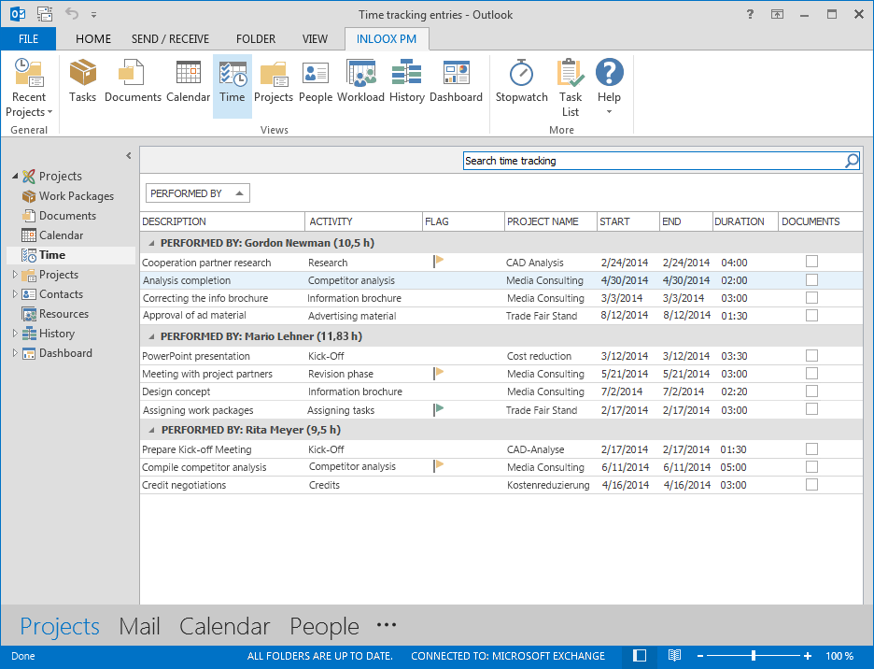
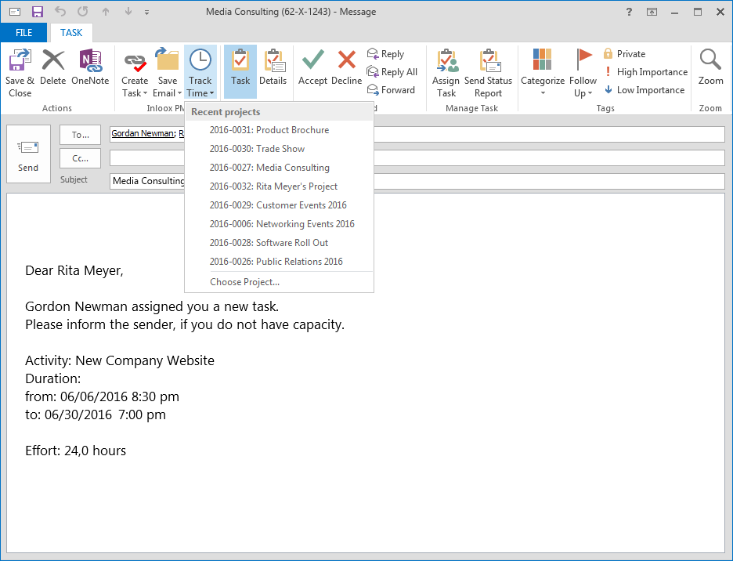

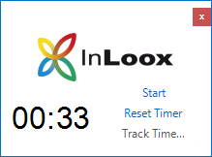
Project time tracking
Time tracking
InLoox for Outlook makes it easy to track time and record the effort needed to complete tasks.
InLoox for Outlook can also take Outlook data (e.g. the sent date of emails) into account to create time tracking entries.
Time tracking with the stop watch
Time how long you need to complete a task and assign it directly to a specific project.

Slide 14
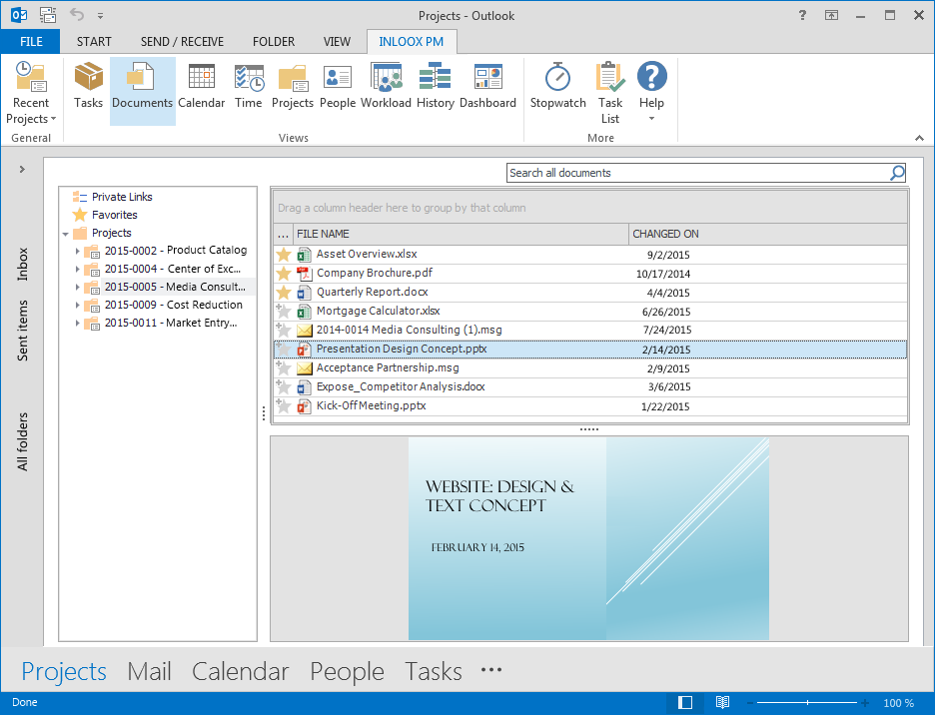
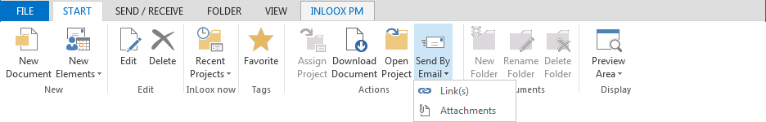

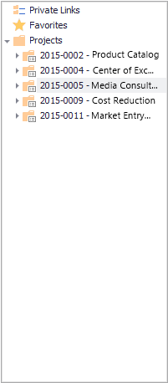

Smart document management
Consistent structure
Organize project documents according to your own filing structure.
InLoox for Outlook supports:
Local drives
Networks
Internet links
Microsoft SharePoint sites
Document preview
Preview your documents directly in InLoox for Outlook.
Send as email
Send project documents via email directly in InLoox.
Favorites
Favorite important documents to find them more quickly.

Slide 15
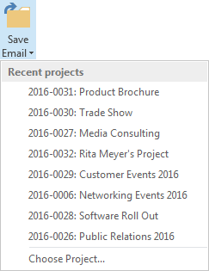
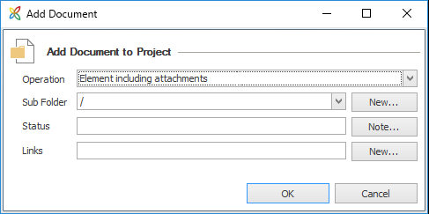
Attach emails with just one click
Assign emails, including attachments, directly to a project
InLoox is always accessible in the Outlook ribbon. This enables you to quickly add emails as a document to a project with just one click.

Slide 16
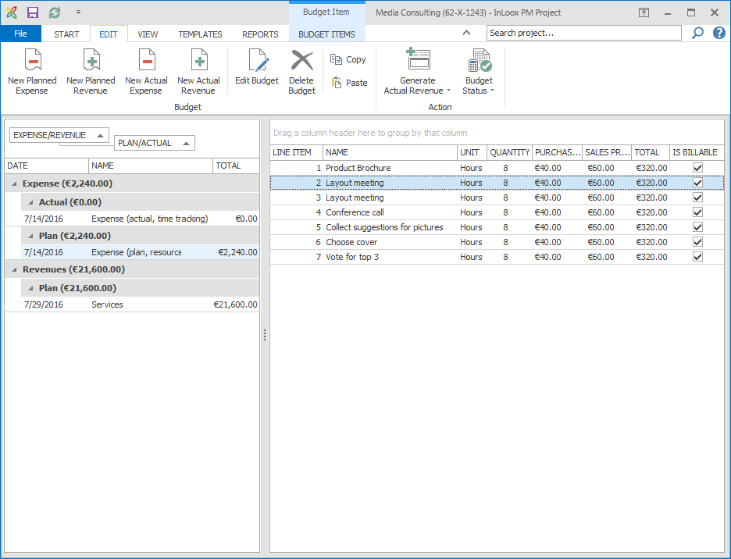
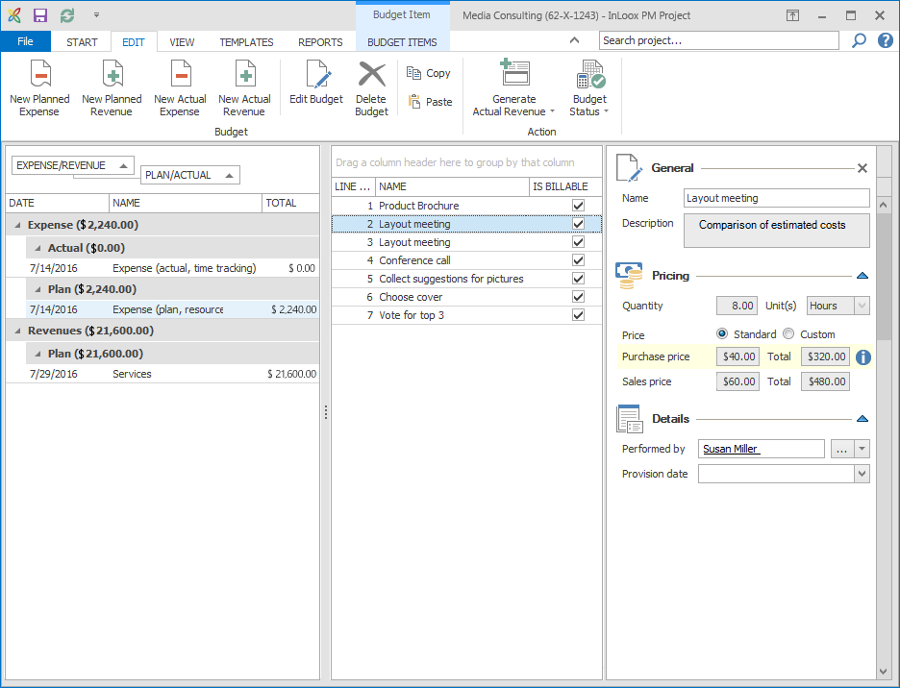
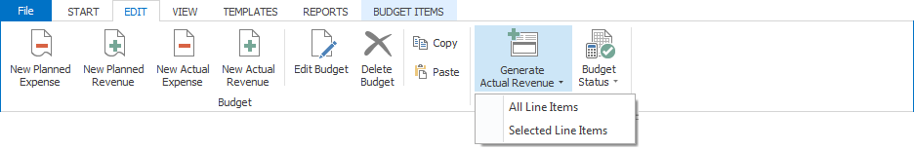
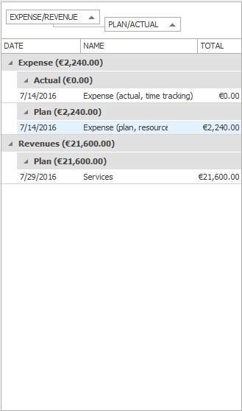
Project budgets made easy
Defining a project budget is easy with InLoox for Outlook: Compare planned and actual expenses and revenues and keep your budget spending under control.
InLoox uses planning positions, time tracking entries and third-party-costs to calculate the project budget.
You can also bill continuous project costs.
InLoox automatically accesses prices, quantity and units from a company-wide budget positions index.

Slide 17
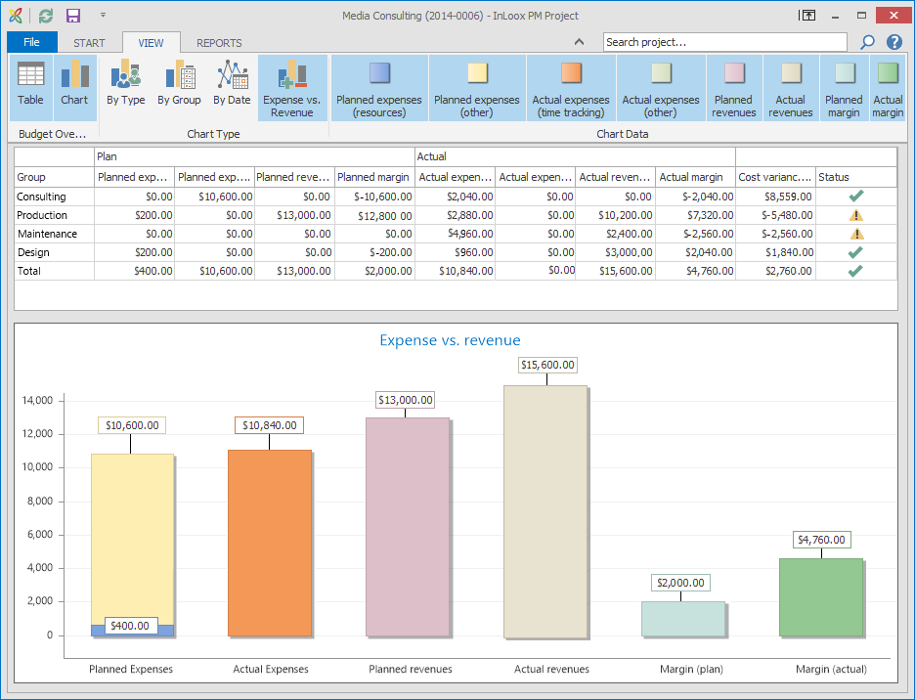
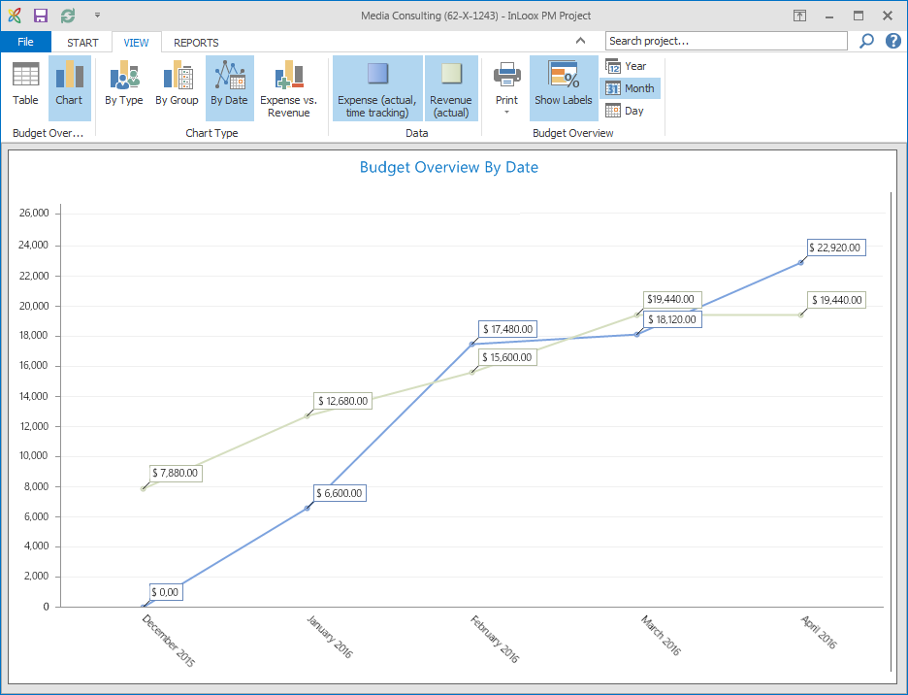


Budget overview
A comparison of planned and actual expenses is visualized in graphs and diagrams.
InLoox is your early warning system – budget overruns are highlighted to alert you to possible financial risks.
Select different types of cost items to be displayed.
Automatically generate monthly cost projections to help you track project costs.

Slide 18
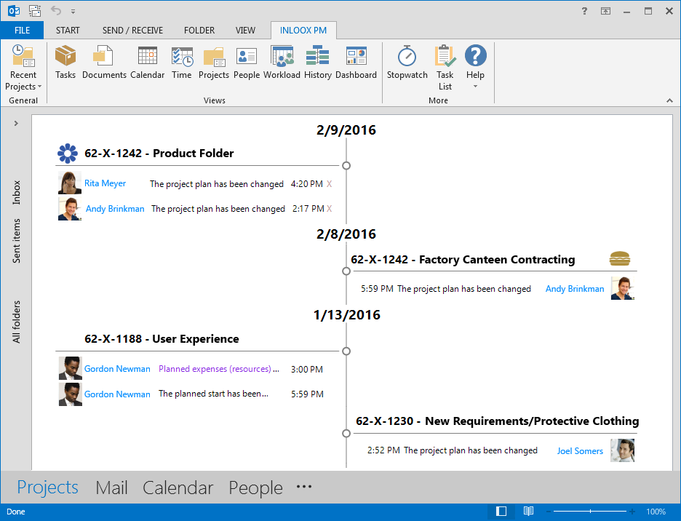
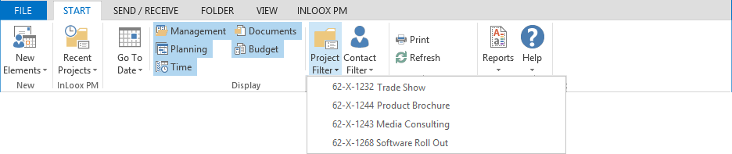
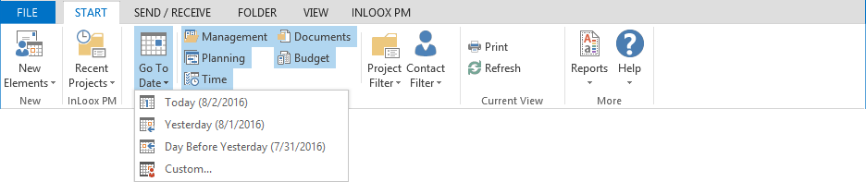

Project timeline
Project history
The project timeline displays important changes in all your projects chronologically.
Click on a project or project element to directly access it.
Use filters to only see your own projects or to only see changes made on a specific date.

Slide 19
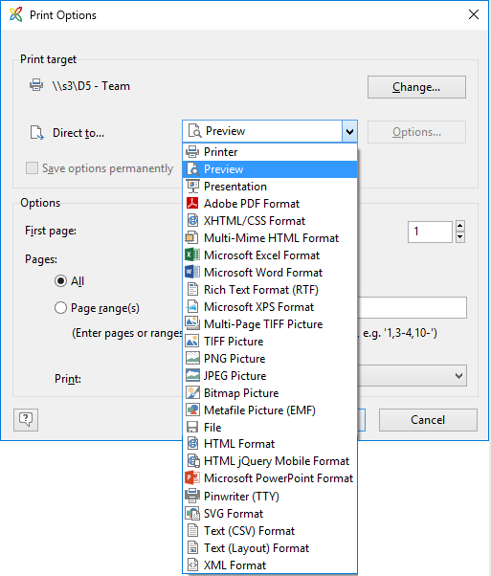
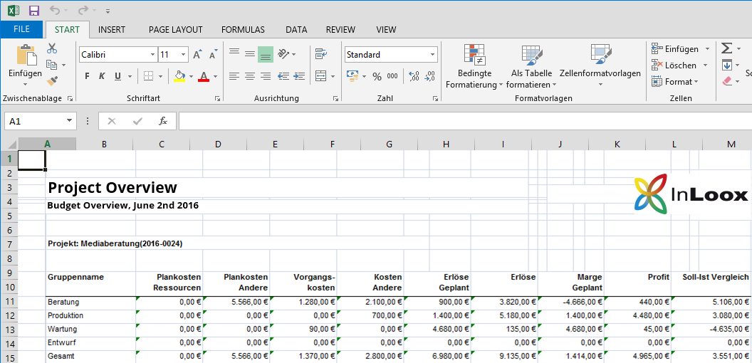
Create comprehensive reports
Create a project report with just one click and make them available in various formats
Supported formats are: Microsoft Word, Excel, RTF, PDF, HTML etc.
Customize report templates with the InLoox Report Designer (standard feature).

Slide 20
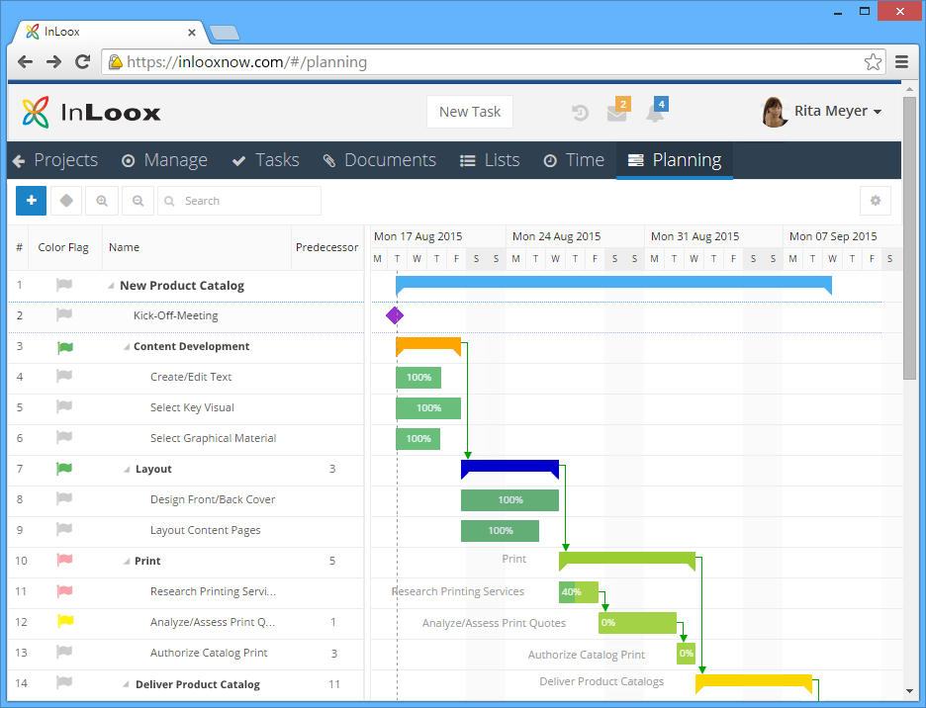
In combination with InLoox 9 Web App
Use InLoox for Outlook in combination with InLoox Web App
Work on one project data base, keeping all your project data up-to-date – whether you access it via InLoox for Outlook or Web App.
InLoox Web App makes it easy to collaborate with external project partners, geographically dispersed project team members, and anybody who is not using Outlook.

Slide 21


In your local network or as a service
InLoox for Outlook in your network
InLoox for Outlook
as SaaS
Recommended for
Enterprises and globally operating businesses
SMBs with their own IT department
Everyone who wants to host their project data on their own servers
Recommended for
Departments without IT support
Freelancers
Small businesses

Slide 22








General information
InLoox has been a standard software since 2003
Over 50,000 users worldwide
Available in 5 languages
Customers in 50 countries, on 5 continents
Read how InLoox helped companies across all industries become more efficient, productive and competitive: http://www.inloox.com

Slide 23
Thank you for your attention!
InLoox for Outlook and InLoox Web App are software distributed by:
InLoox GmbH | Kantstr. 2 | D-80807 Munich
Phone: +49 (0)89 358 99 88 - 0 | Fax: +49 (0)89 358 99 88 - 99
Email: info@inloox.com | www.inloox.com
Alle in diesem Dokument genannten Produktnamen, Produktbezeichnungen und Logos
sind eingetragene Warenzeichen und Eigentum der jeweiligen Rechteinhaber.
Test InLoox 30 days for free (trial ends automatically): https://www.inloox.com/free-trial/

