Slide 1
InLoox product presentation
Project management software, integrated into Microsoft Outlook

Slide 2
Contents
Project overview
Integration into Outlook, dashboard, project lists
Management page
Base data, contacts, notes
Mind Mapping page
Mind Maps, nodes, copy to planning
Planning page
Activities, milestones, resources
Time tracking page
Time tracking items, time recording, calendar entries
Document page
Document management for files and Outlook items
Budget page
Project expenses and revenues
Budget overview page
Diagram types
Quick access panels
Email, appointment/task, contact

Slide 3
Project management software for Outlook
InLoox is the reliable and flexible solution for professional project management: the software is integrated directly into Microsoft Outlook and facilitates the combined management of projects, documents, resources, Mind Maps and budgets.
Project planning
Budgets
easy-to-use
+ 25,000 users
= a solution, that works
Time tracking
Document management

Slide 4
InLoox brings extra features to Microsoft Outlook
Communicate, plan, organize in Outlook
Manage projects in Outlook - with InLoox

Slide 5
Dashboard – important project data at a glance
All relevant and project-related information for handling, control and analysis
„Important figures, deadlines and milestones are under control at anytime. Your project portfolio is transparent and easy-to-handle.“

Slide 6
Powerful and personalized views
Compose your personal dashboard from different project widgets

Slide 7
InLoox toolbar
InLoox is always available with one click
Quick access to recent projects from all Outlook views
Documents and activities
Add emails, attachments, and files directly from Outlook task, calendar and inbox folders
High performance report generator
Supported formats: Microsoft Word, Excel, PDF, and many more

Slide 8
InLoox folder
The InLoox folder contains all projects in one central overview
„Benefits: maximum availability and transparency for each user“

Slide 9
Stay informed with one click
InLoox fields for project management
project status, project priority
company, customer, etc.
Predefined information rules
time warning = overdue project
grey = closed project

Slide 10
Structured project information
Powerful full text search covering all projects, plans, budgets, etc.
Group, filter and flag
according to many criteria

Slide 11
Global views and workflows
Personal and public views for teams
Additional InLoox fields for extended project information
project managers, start, end
document folder, customer, etc.

Slide 12
Open a project
In the project list a row corresponds to one project
A double click opens a project

Slide 13
A project in detail
A tab for each project module:
Management
Mind Mas
Planning
Time tracking
Documents
Budgets
Budget overview
InLoox displays each project in one consistent structure. Instead of handling of a complicated application, your projects are in the focus

Slide 14
Project definition and identification
Project name
Explicit project number in a free definable format
Division
Customer
Central category list for portfolio structuring, e.g.:
Trading area
Customer group
Department

Slide 15
Clear responsibilities
Project contacts:
Project manager
Team members
Customer(s)
Partner
Outlook address books and
Exchange Global Address Lists (GAL) are used without doublets or synchronization
More contacts, e.g. stakeholders, influencers, etc.
→ Free configurable roles assign project rights to responsible persons

Slide 16
Status and time frame
Status
Schedule
Start / end
Priority
„Soft“ or „hard“ deadline
Move project to archive

Slide 17
Project notes with modification details
Automatic author and date documentation
Settles project goals and mission statements

Slide 18
Flexibility with custom fields
Possibility for adding custom data fields (integer, currency,
date time, open and closed lists and much more), without programming knowledge
Extend the InLoox data model with own, company-specific fields

Slide 19
Collect, organize and visualize ideas
Mind Mapping
Collect and organize ideas and information on your project directly in InLoox, so that they can later be transferred to the project time plan

Slide 20
Design your Mind Map
Create new Mind Map
Create new node
Highlight nodes with symbols, colors, or frames
Dependency between parent node and sub-node
Additional information:
Allocated resources
Document links
Progress

Slide 21
Node details
Create new node
Multiline description
Progress
Flag a node. The handling is the same as in Microsoft Outlook

Slide 22
Node details: adding resources
Resource allocation for further planning and work package definition
Outlook contacts and Exchange directories are supported

Slide 23
Template support
Mind Map templates speed up the brainstorming in recurring or similar projects
Templates are free definable, e.g.:
Employee introduction
QA project
Strategy project
IT planning

Slide 24
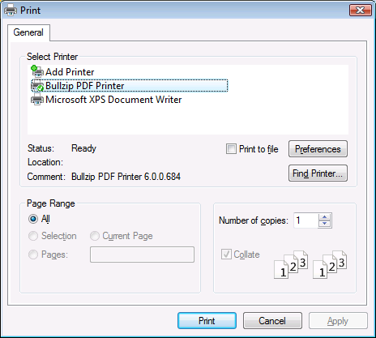
Mind Mapping: printing and exporting
Print, e.g. in Letter (8,5” x 11) format available
Any printers, e.g. Microsoft Document Writer
Mind Maps can be exported as pictures and used for other applications

Slide 25
Transfer to the project time plan
Mind Maps can be transferred conveniently to the project time plan
The result is a seamless planning process – from the first brainstorming to implementation

Slide 26
Activities and milestones at a glance
Project time planning
Define milestones, activities and resources for your project

Slide 27
Gantt chart overview
Create new activities, work packages and milestones
Critical activities, summary tasks or milestones are marked red
Dependencies between planning elements (predecessors/successors)
Reminder and status
Flag elements in the project plan just like in Microsoft Outlook
Additional information:
Allocated resources
Linked documents
Activity overdue

Slide 28
Create activities and milestones
Create new activities or milestones
Element name
Project structure plan code
Beginning, duration or end
Fix element

Slide 29
Add resources
Both Outlook and Exchange Server contacts are supported
Automatic resources notification
via email
with InLoox
Appointment request
Task request
Automatic capacity calculation
Data and instructions are communicated to resources automatically, if desired

Slide 30
InLoox informs resources
Work packages won’t get out of sight
Open work packages will be generated from the project plan and displayed in Microsoft Outlook
Proactive communication
InLoox informs or reminds users about new and upcoming work packages
Automatic reminder function
Work packages can be synchronized with Outlook calendar and task folders

Slide 31
Feedback of project progress
One click shows a detailed information of the individual work packages
Progress will be communicated automatically to the project plan

Slide 32
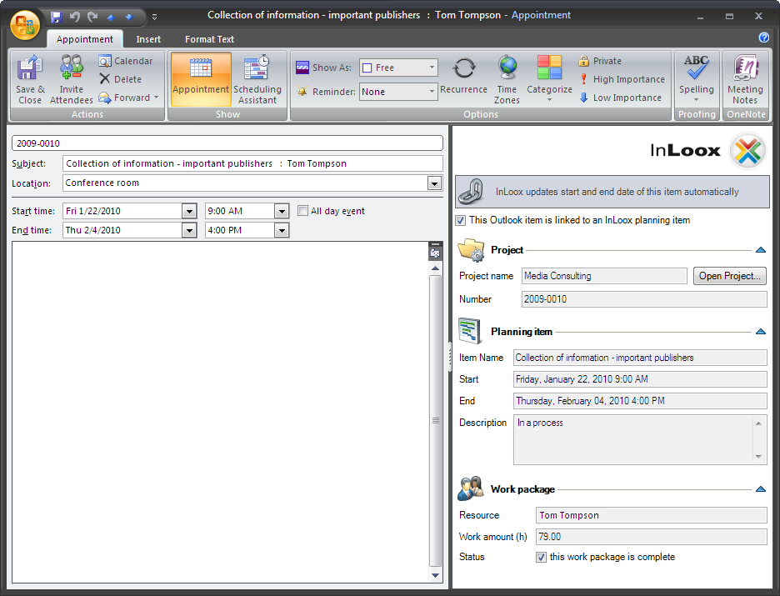
Synchronize appointments with the project plan
InLoox can display important milestones in the calendar. All important deadlines are thus always in view and stay up to date if any of the project plans change
Appointment or task changes will be automatically synchronized

Slide 33
Resource workload overview
View resource utilization by activity, project or system-wide, with one click
Check workload of staff or material (infrastructure, equipment)
InLoox reports resource overbooking, the project manager decides or adjusts bottlenecks
Integration into Microsoft Outlook
InLoox registers free/busy information from Exchange. Thus, the utilization view includes appointments, absences, part-timers, etc. with no additional effort

Slide 34
Resource utilization diagram
Individual resources are shown by the resource utilization diagram
The overview indicates free capacities, average load and bottlenecks

Slide 35
Project planning: printing
Print in various formats, e.g. letter (8,5” x 11) or banner
Any printers, e.g. Microsoft Document Writer

Slide 36
Planning templates
Load existing templates from InLoox or other applications, such as Microsoft Project, which don’t even have to be installed
Select a template
Templates are free definable, e.g.:
Employee introduction
QA project
Strategy project
IT planning

Slide 37
Project time tracking
Activity and time recording
Project history contains alls steps, gathered directly and conveniently from Outlook calendar or inbox

Slide 38
Time tracking item details
Create a time tracking item
Linking into service-group
Alternatively, when booked to an activity, plan/actual workload is determined, i.e. the deviation of the actual implementation time from the project plan

Slide 39
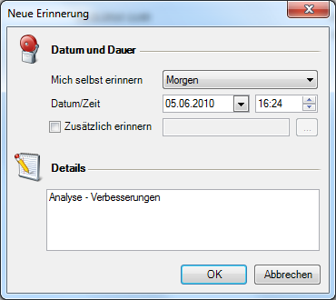

Reminder function and follow-ups
Reminders
A reminder function permits automatic follow-ups or tracking, e.g. for those tasks that need special attention
Outlook calender

Slide 40
Documentation storage and file organization
Document management feature
Files, links and Outlook elements can be saved and organized in the corresponding project folder

Slide 41
Project folder
Assign documents
All documents, emails, notes, protocols and reports of a project
are stored centrally
Document folder view with the powerful 1-click-filtering
Project file organisation and overview
Supported types:
local storage
storage on network shares
Internet links
Microsoft SharePoint sites

Slide 42
Document detailed information
Freely-definable status
Authorisation required, new version,
30% completed etc.
Multiline comments and additional
information
Document can be linked to the time tracking activity
The documents can be called up easily and quickly from the project history

Slide 43
Email assignment with one click
Emails, which include attachments, can be assigned directly to the project
InLoox offers a special function, which is always available from any part of Outlook
Add to the corresponding project

Slide 44
Budget projects easily
Project budgets
Calculate, schedule, approve and invoice expenses and revenues

Slide 45
Budgets and budget positions
Project costs are organized in budgets. InLoox distinguishes between:
Expenses (e.g. for resources, suppliers)
Revenues (e.g. invoices)
Each budget contains one or more positions
Budgets and positions have a unique identification number

Slide 46
Register expenses
Time tracking items are automatically registered as expenses
Internal rates calculate project work cost
Cost rates and cost centers are freely-definable in the options
InLoox shows you which costs have already been invoiced to the customer
Identify concealed project costs and control your profits
The project manager decides about billing them to the customer

Slide 47
Create budgets
Budget document type
Unique identifier
Date
Status (free configurable)
Budget name
Author identification:
User name from Microsoft Exchange / Microsoft Outlook
Transfer positions from existing
budgets:
not yet billed
all

Slide 48
Load templates
Budget templates include predefined budget positions and save time with recurring or similar projects
Template positions are displayed

Slide 49
Create budget positions
Select a position template
InLoox automatically loads prices, description, amount and units from pre-defined budget position templates
Position group
Name
Multiline description
Freely-definable units, e.g.:
Minutes, days, months,
Meters, inches, parts, etc.
All-inclusive, flat, etc.

Slide 50
Budget overview
Compare planned and actual expenses and revenues visually

Slide 51
Early warning system and cost control
Actual expenses, resource and additional costs
Planned expenses, resource and additional costs
Currencies:
$, £, ¥, EUR, CHF, etc.
Planned/actual expenses comparison
Budget overruns are marked red

Slide 52
Cost breakdown
Expenses and revenues are broke down according to group or cost center

Slide 53
Cost trend monitoring
Temporal sequence of revenues and expenses
Views by days, months or years

Slide 54
Create detailed reports
Exporting of data and evaluation to several formats
Supported formats are Microsoft Excel, RTF, PDF, HTML and many more
The InLoox report designer allows to customize report templates (a part of the standard package)

Slide 55
Project marketing with email templates
Predefined templates reduce the time you spend writing emails and allow rapid project communication
Time tracking items (appointments, work times) and documents (such as emails, file attachments, etc.) can be transferred directly from Outlook to the project

Slide 56
Quickly recognize project relations
InLoox automatically links Outlook contacts to the relevant project
Without even opening a project, it is easy to see which contacts belong to your projects – and which roles they take

Slide 57







Facts and figures
Standard product since 2003
Worldwide installations: more than 25.000 users
User interface in seven languages
Some companies, that already use InLoox:
Find more references and case studies at http://www.inloox.com

Slide 58
Thank you for your attention!
InLoox is a software of:
InLoox GmbH | Kantstr. 2 | D-80807 Munich
Telephone: +49 (0)89 323 919 22 | Fax: +49 (0)89 323 919 55
Email: info@inloox.com | www.inloox.com
All specified product names, product designations and logos in this document are registered trade marks and property of the respectiv right owners..

